Slide 1



Conserving evolutionary processes
Jeffrey Hanson
jeffrey.hanson@uqconnect.edu.au
jeffrey-hanson.com

Slide 2


Acknowledgements
Richard Fuller
Jonathan Rhodes
Cynthia Riginos
Hugh Possingham
Stuart Butchart
Graeme Buchanan
Carlo Rondinini
Francesco Ficetola
IntraBioDiv project
NeCTAR

Slide 3
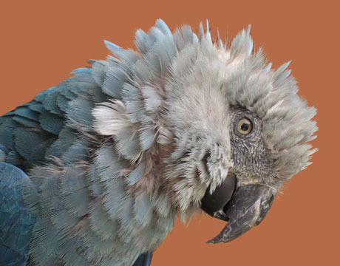
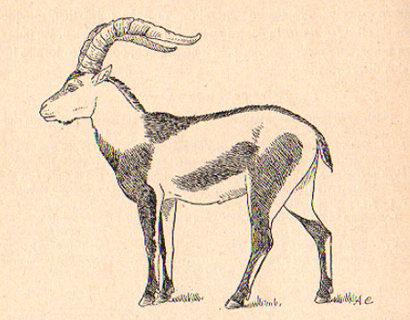
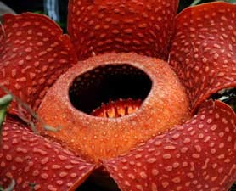
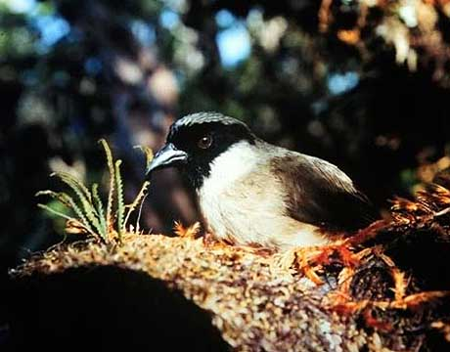
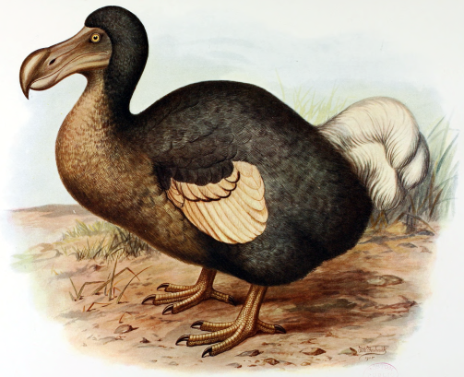
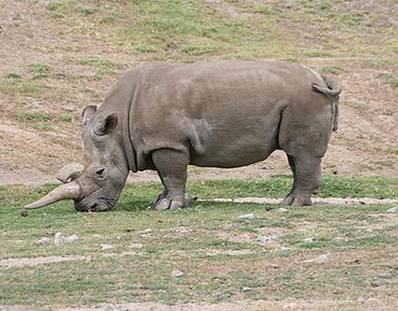
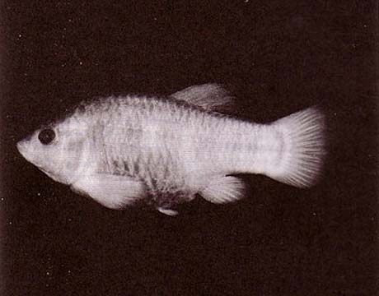
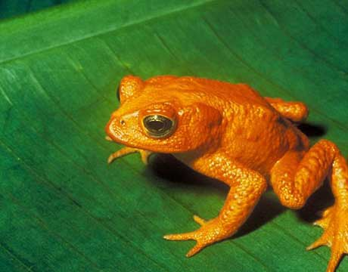
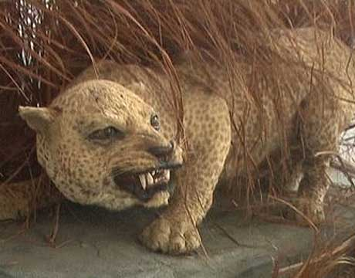
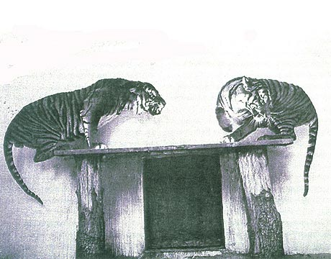
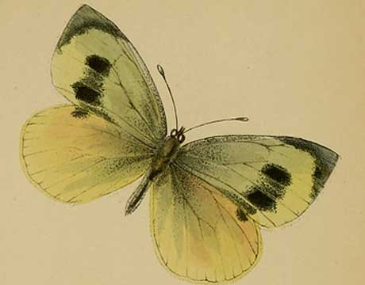
Global biodiversity crisis
Notes:
- high extinction rate
- conservation aims to maintain existing patterns of biodiversity and the processes that sustain them
- areas set aside to preserve biodiversity, and spearhead direct management actions

Slide 4
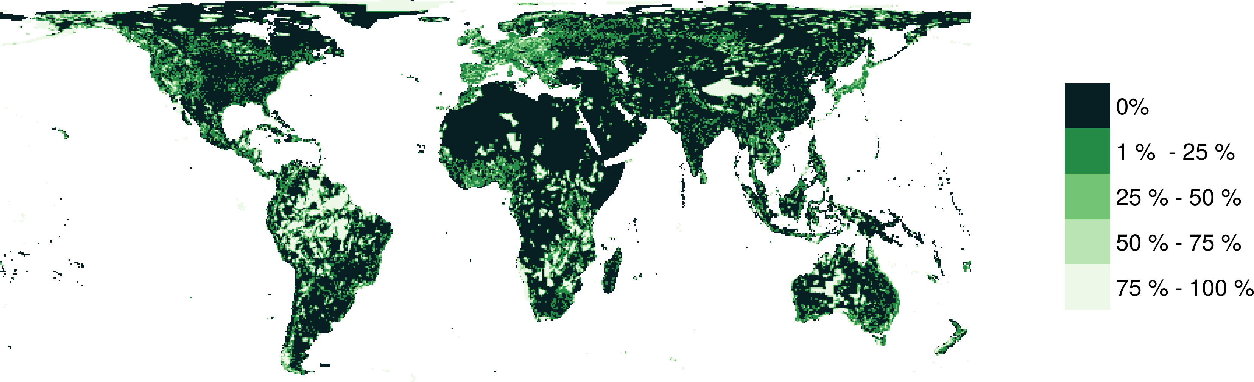
Protected areas

Slide 5
Reserve selection
Notes:
- not all remaining habitat can be preserved
- achieve conservation objectives for minimal cost
- modern systematic conservation planning primarily focusses on representing species
- however, this ignores intra-specific biodiversity

Slide 6
Reserve selection

Slide 7
Reserve selection

Slide 8
Evolutionary processes
Species range
Population

Slide 9
Evolutionary processes
Species range
Population

Slide 10
Evolutionary processes
Species range
Population

Slide 11
Evolutionary processes
Species range
Population

Slide 12
raptr: Representative and adequate prioritization toolkit in R
Hanson et al. (2017) 10.1111/2041-210X.12862

Slide 13
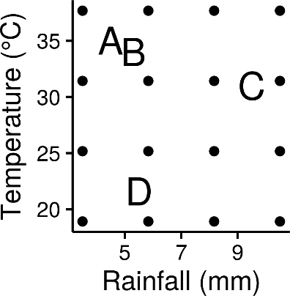
Attribute space

Slide 14
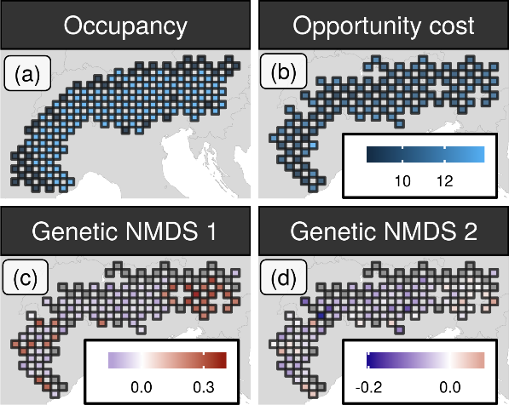
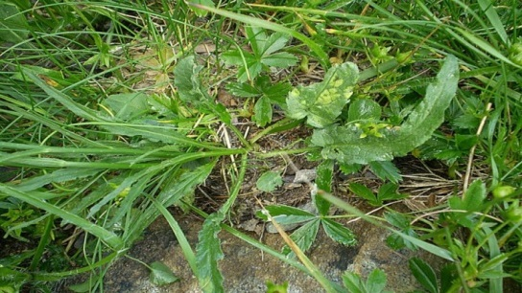
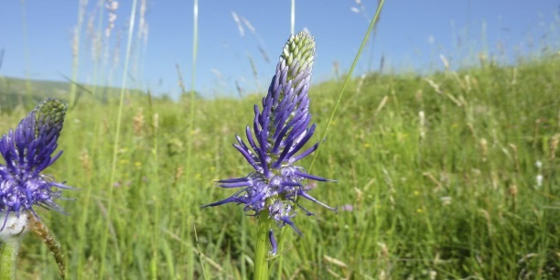
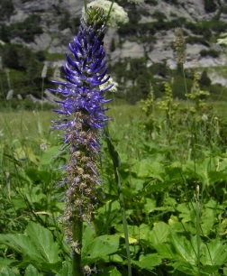
Case study
betony leaved rampion

Slide 15
Case study
betony leaved rampion

Slide 16
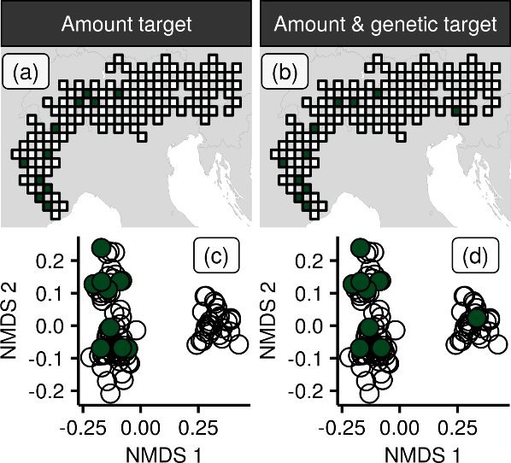
Case-study
10 % habitat
target
10 % habitat
target
+
95 % genetic
variation target

Slide 17
Case-study
10 % habitat
target
10 % habitat
target
+
95 % genetic
variation target

Slide 18
Environmental and geographic variables are effective surrogates for conservation planning
Hanson et al. (2017) 10.1073/pnas.1711009114.

Slide 19
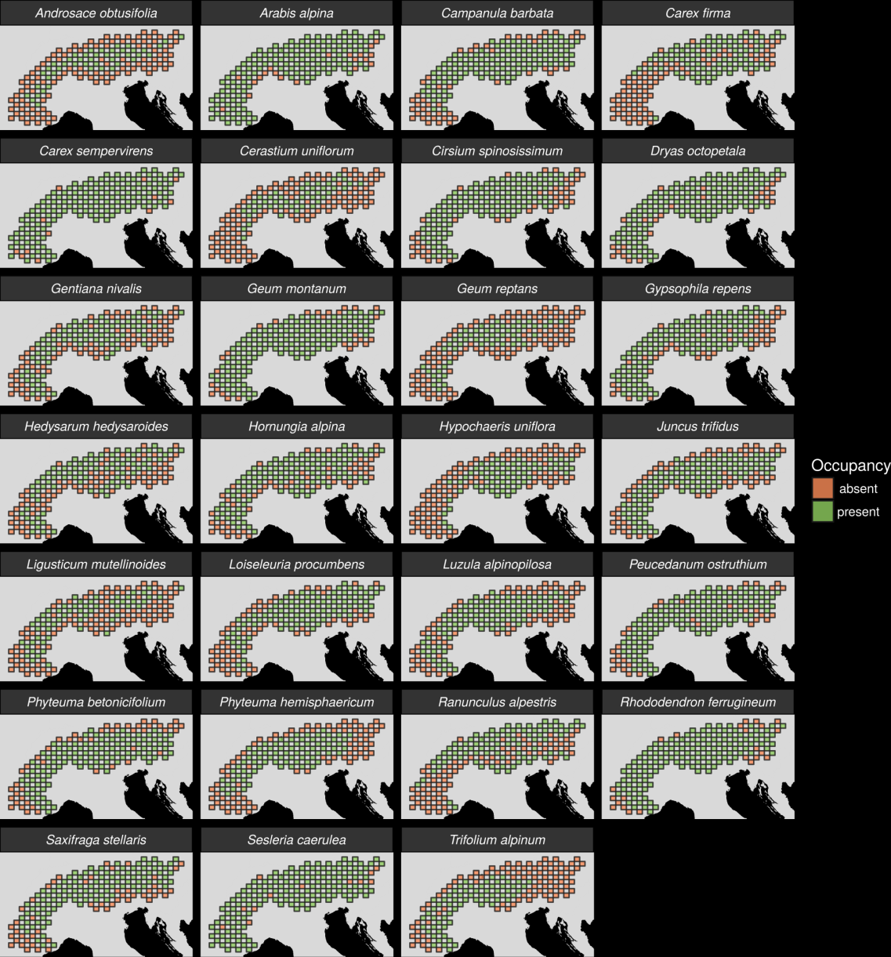
27 plant species
Different dispersal
Different life-histories
Different niches

Slide 20
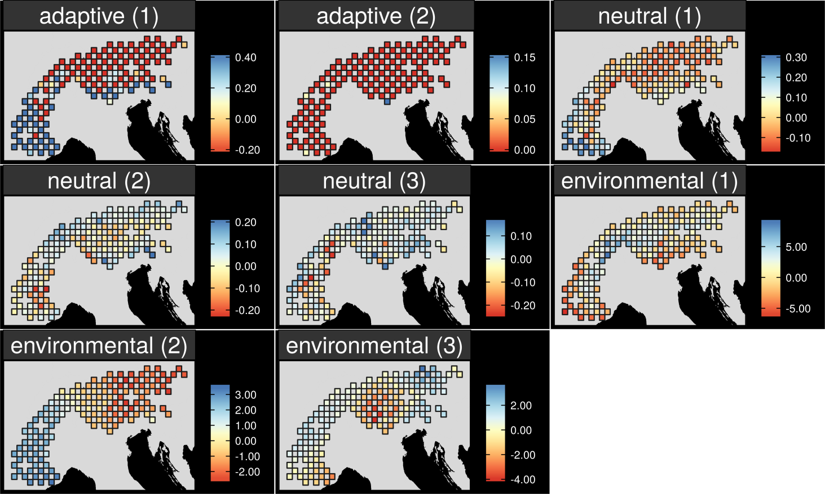
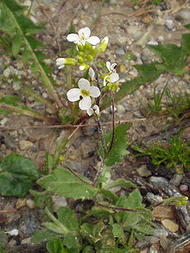
Map intra-specific genetic variation
Arabis alpina

Slide 21
Map intra-specific genetic variation
Arabis alpina

Slide 22
Map intra-specific genetic variation
Arabis alpina

Slide 23
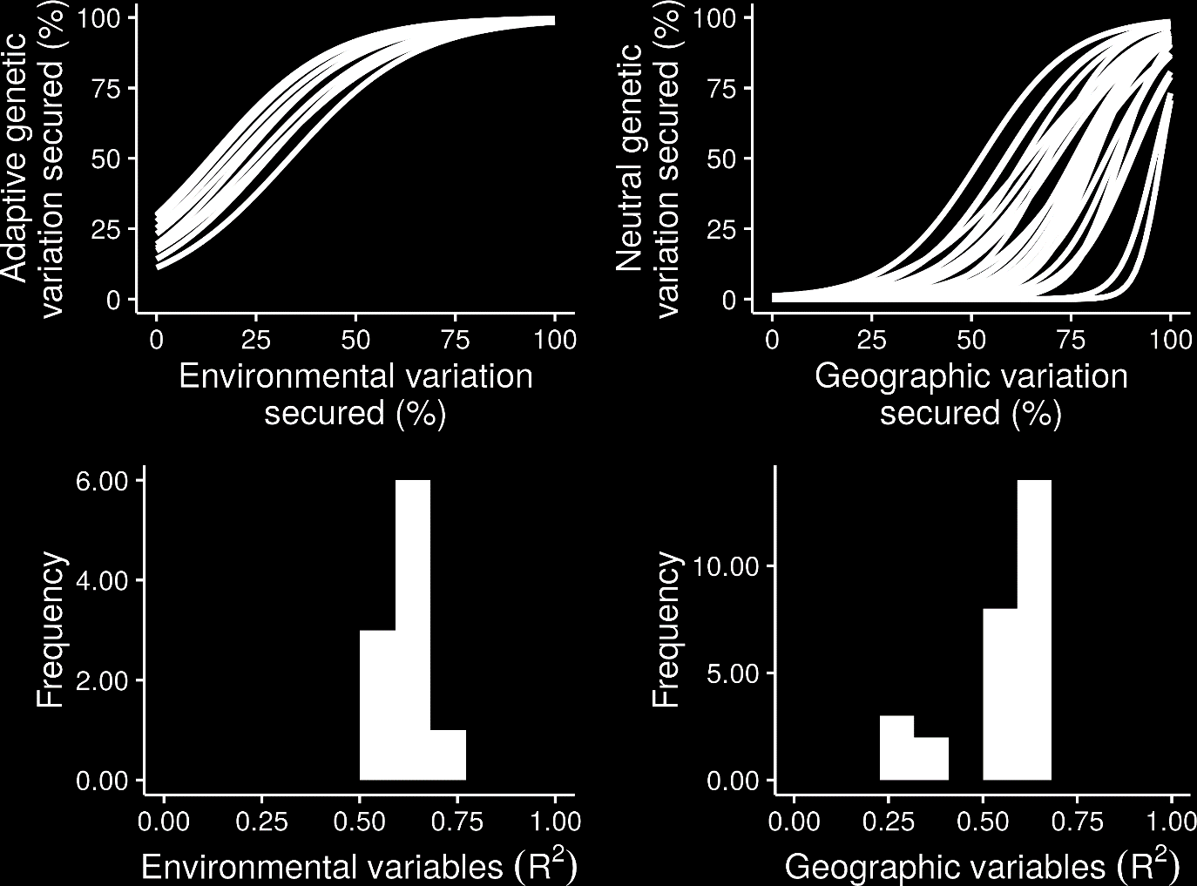
What is the relationship?

Slide 24
What is the relationship?

Slide 25
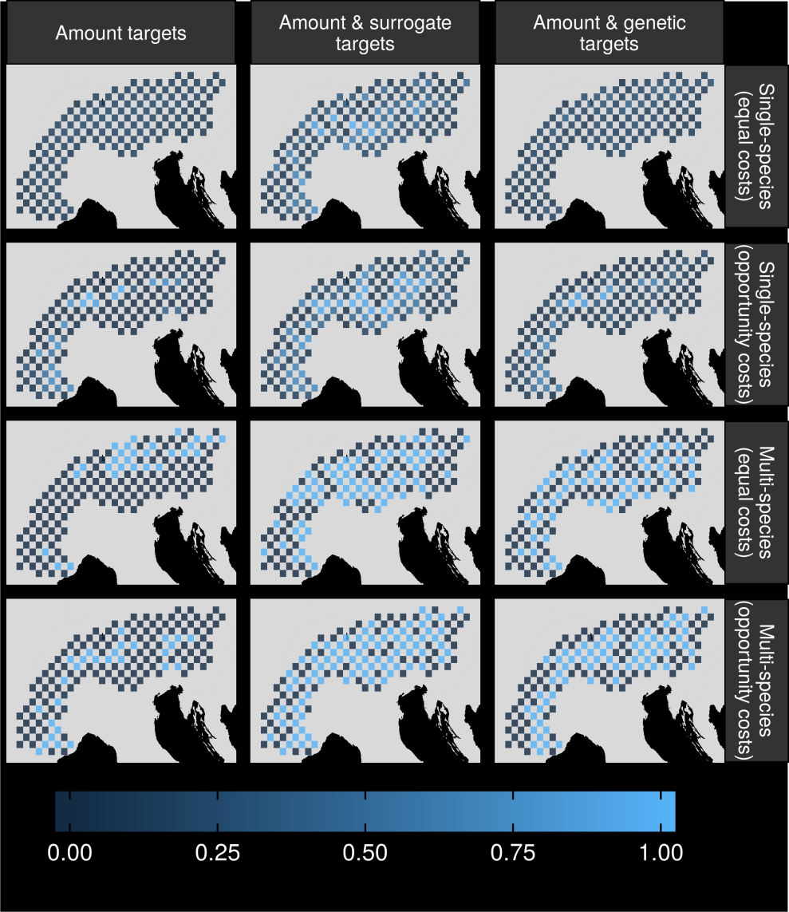
Can we make better decisions using surrogates?

Slide 26
Can we make better decisions using surrogates?

Slide 27
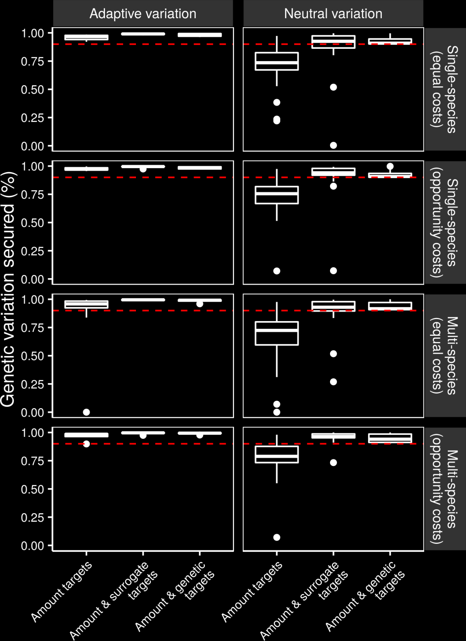
Can we make better decisions using surrogates?

Slide 28
Can we make better decisions using surrogates?

Slide 29
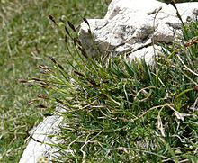
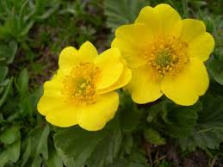
Surrogate performance
Effective for most studied species
Conventional methods may capture adaptive variation
Performance of geographic distances may depend on dispersal mechanisms

Slide 30
How good are conventional approaches for capturing gene flow and can we do better?
In prep.

Slide 31
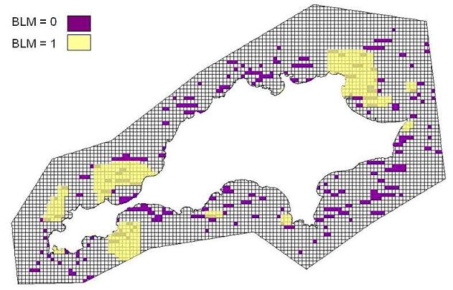
Conventional approach for maintaining connectivity
More clumped -> more connectivity
No species-specific data
No landscape or genetic data

Slide 32
Reserve selection using genetic data
Suitable habitat
Dispersible habitat
Solution

Slide 33
Reserve selection using surrogate
Suitable habitat
Suitability as surrogate
Solution

Slide 34
Performance evaluation
Genetic-based solution
Surrogate-based solution

Slide 35
Performance evaluation
Genetic-based solution
Dispersible habitat
Surrogate-based solution
Maximum 8 units of
connected habitat
Maximum 5 units of
connected habitat

Slide 36
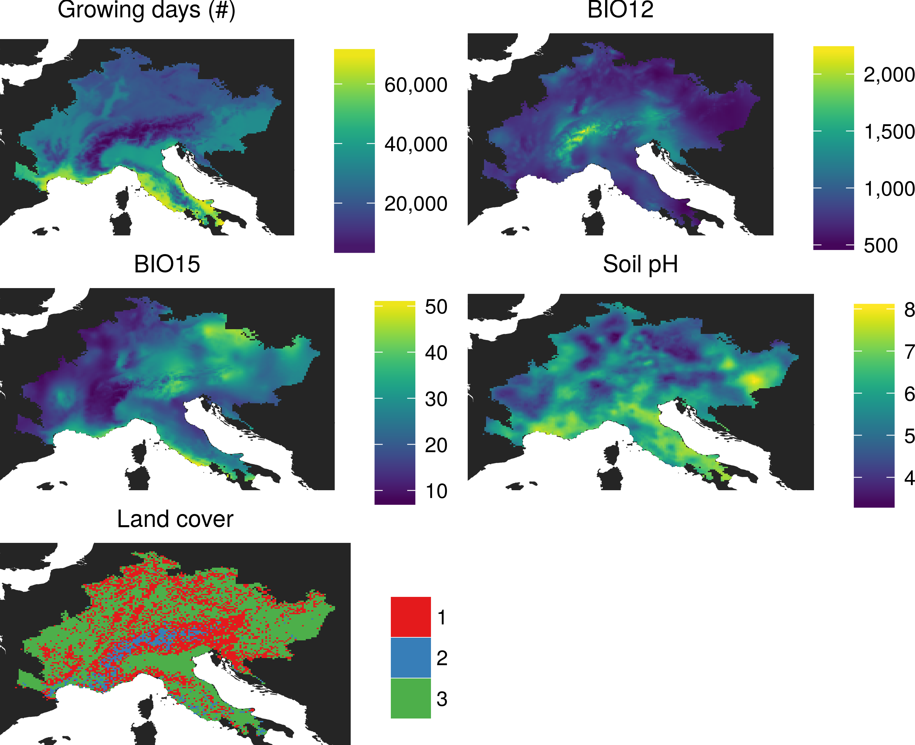
Environmental data

Slide 37

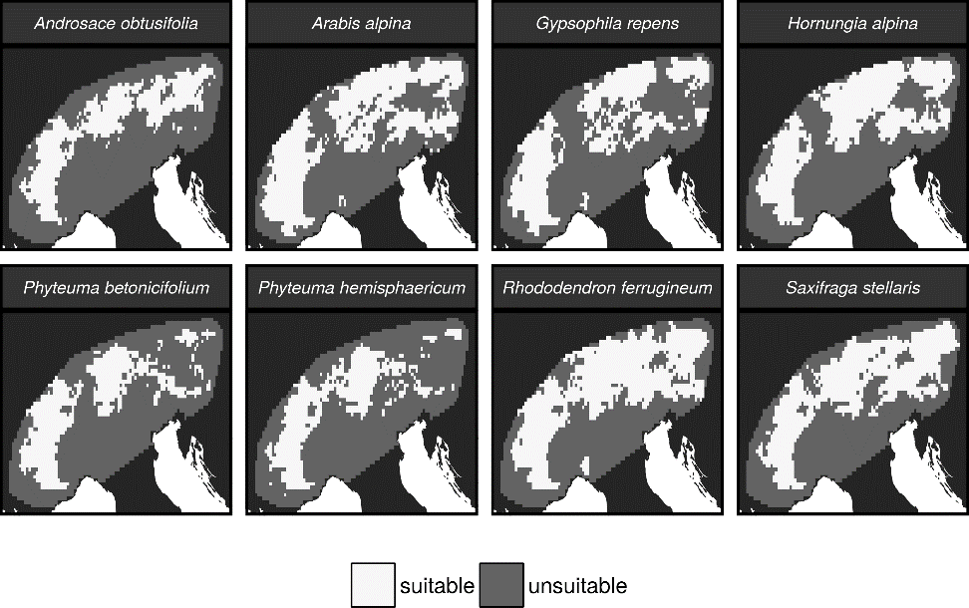
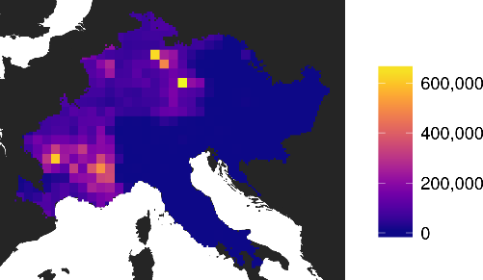

Environmental data
Suitable habitat
Occurrence records from
online sources

Slide 38
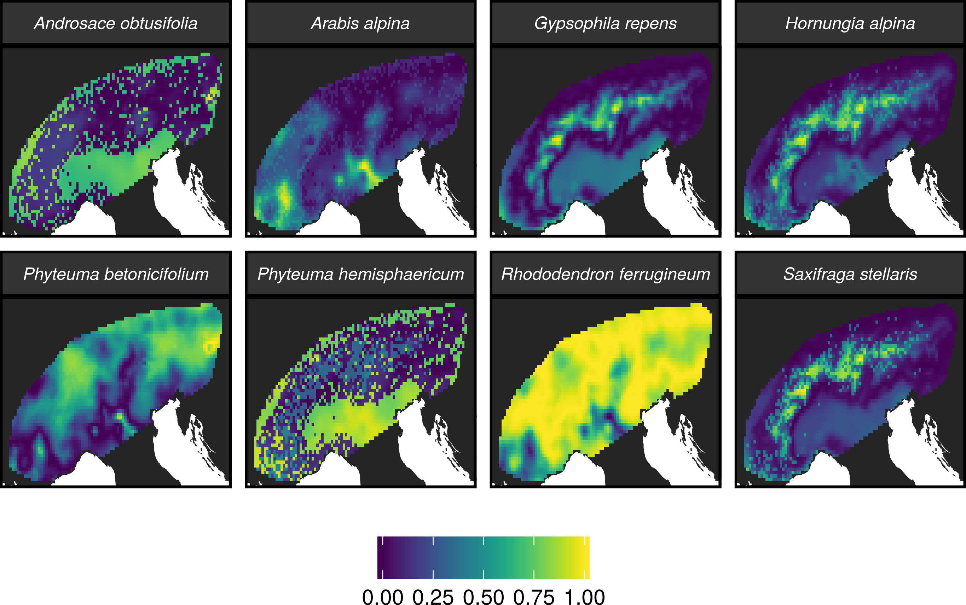

Environmental data
Resistance to gene flow maps
Genetic data

Slide 39
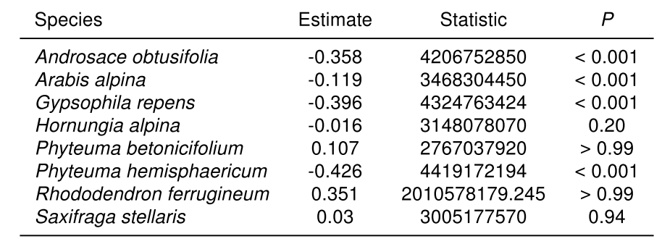
Does habitat suitability correlate with resistance to gene flow?
Spearman’s correlation test

Slide 40
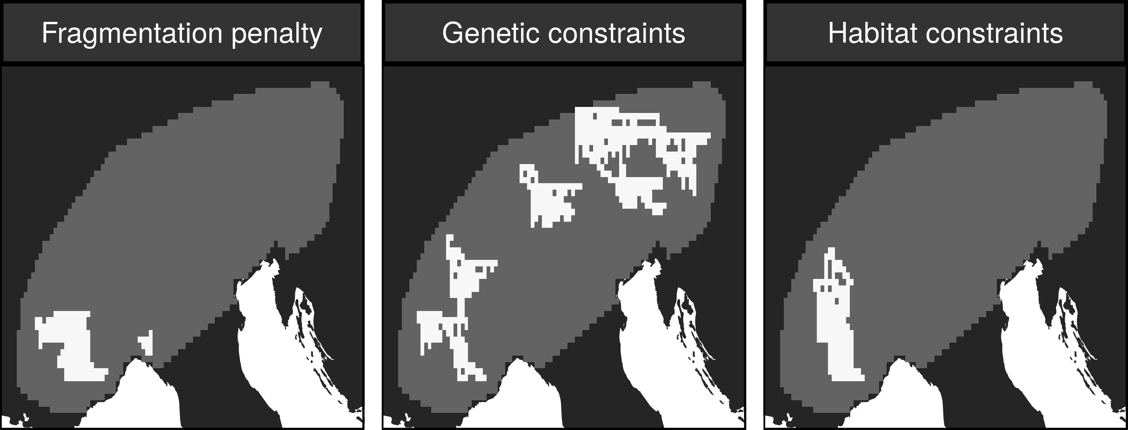
Do we need genetic data to maintain gene flow?

Slide 41
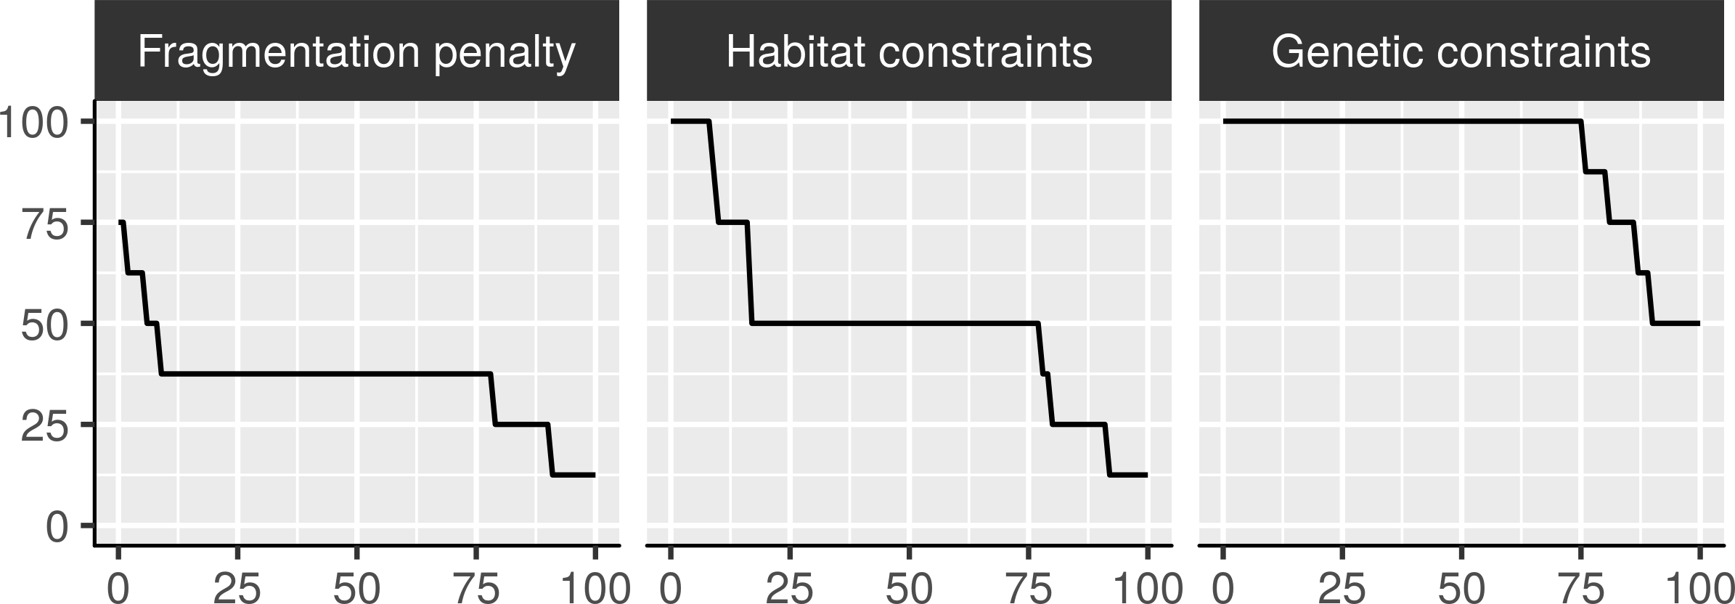
Do we need genetic data to maintain gene flow?
Percent of species with
gene flow maintained
Strength of gene flow required in prioritization
(percentile threshold)

Slide 42
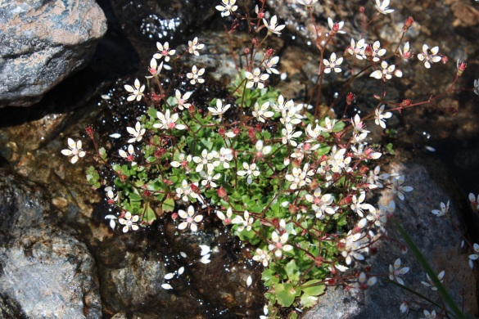
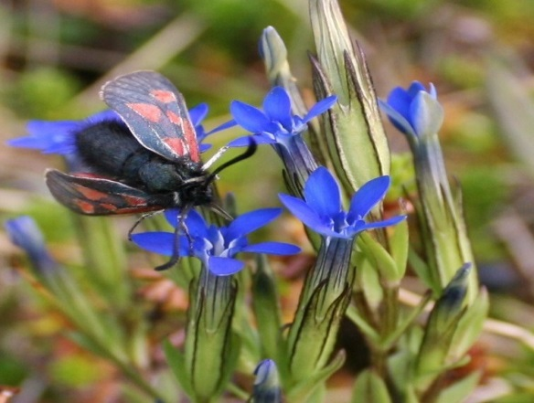
No surrogate for gene flow identified
Genetic data was needed to make prioritizations that could maintain strong levels of gene flow
Potentially complicated by dispersal mechanisms
We can incorporate species-specific connectivity into prioritizations

Slide 43
Global conservation of realized niches
How well are species’ realized niches represented in existing protected areas?
Do we need to consider species’ realized niches when developing prioritizations?
In prep.

Slide 44
Species data
9,706 bird, 5,156 mammal, 5,259 amphibian species
5 × 5 km maps showing suitable habitat
Habitat targets set following standard approaches
Split each species’ distribution into 25 “environmental” partitions

Slide 45
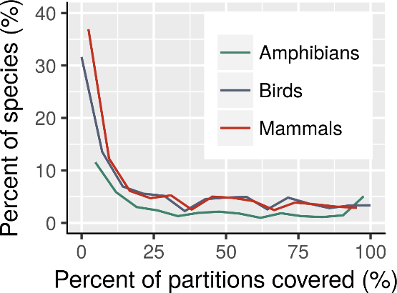
How good is the existing protected system?
19,402 species are not adequately represented in reserves
10,589 species have less than 3/25 of their partitions secured
Of these 10,589, 2,711 species are globally threatened

Slide 46
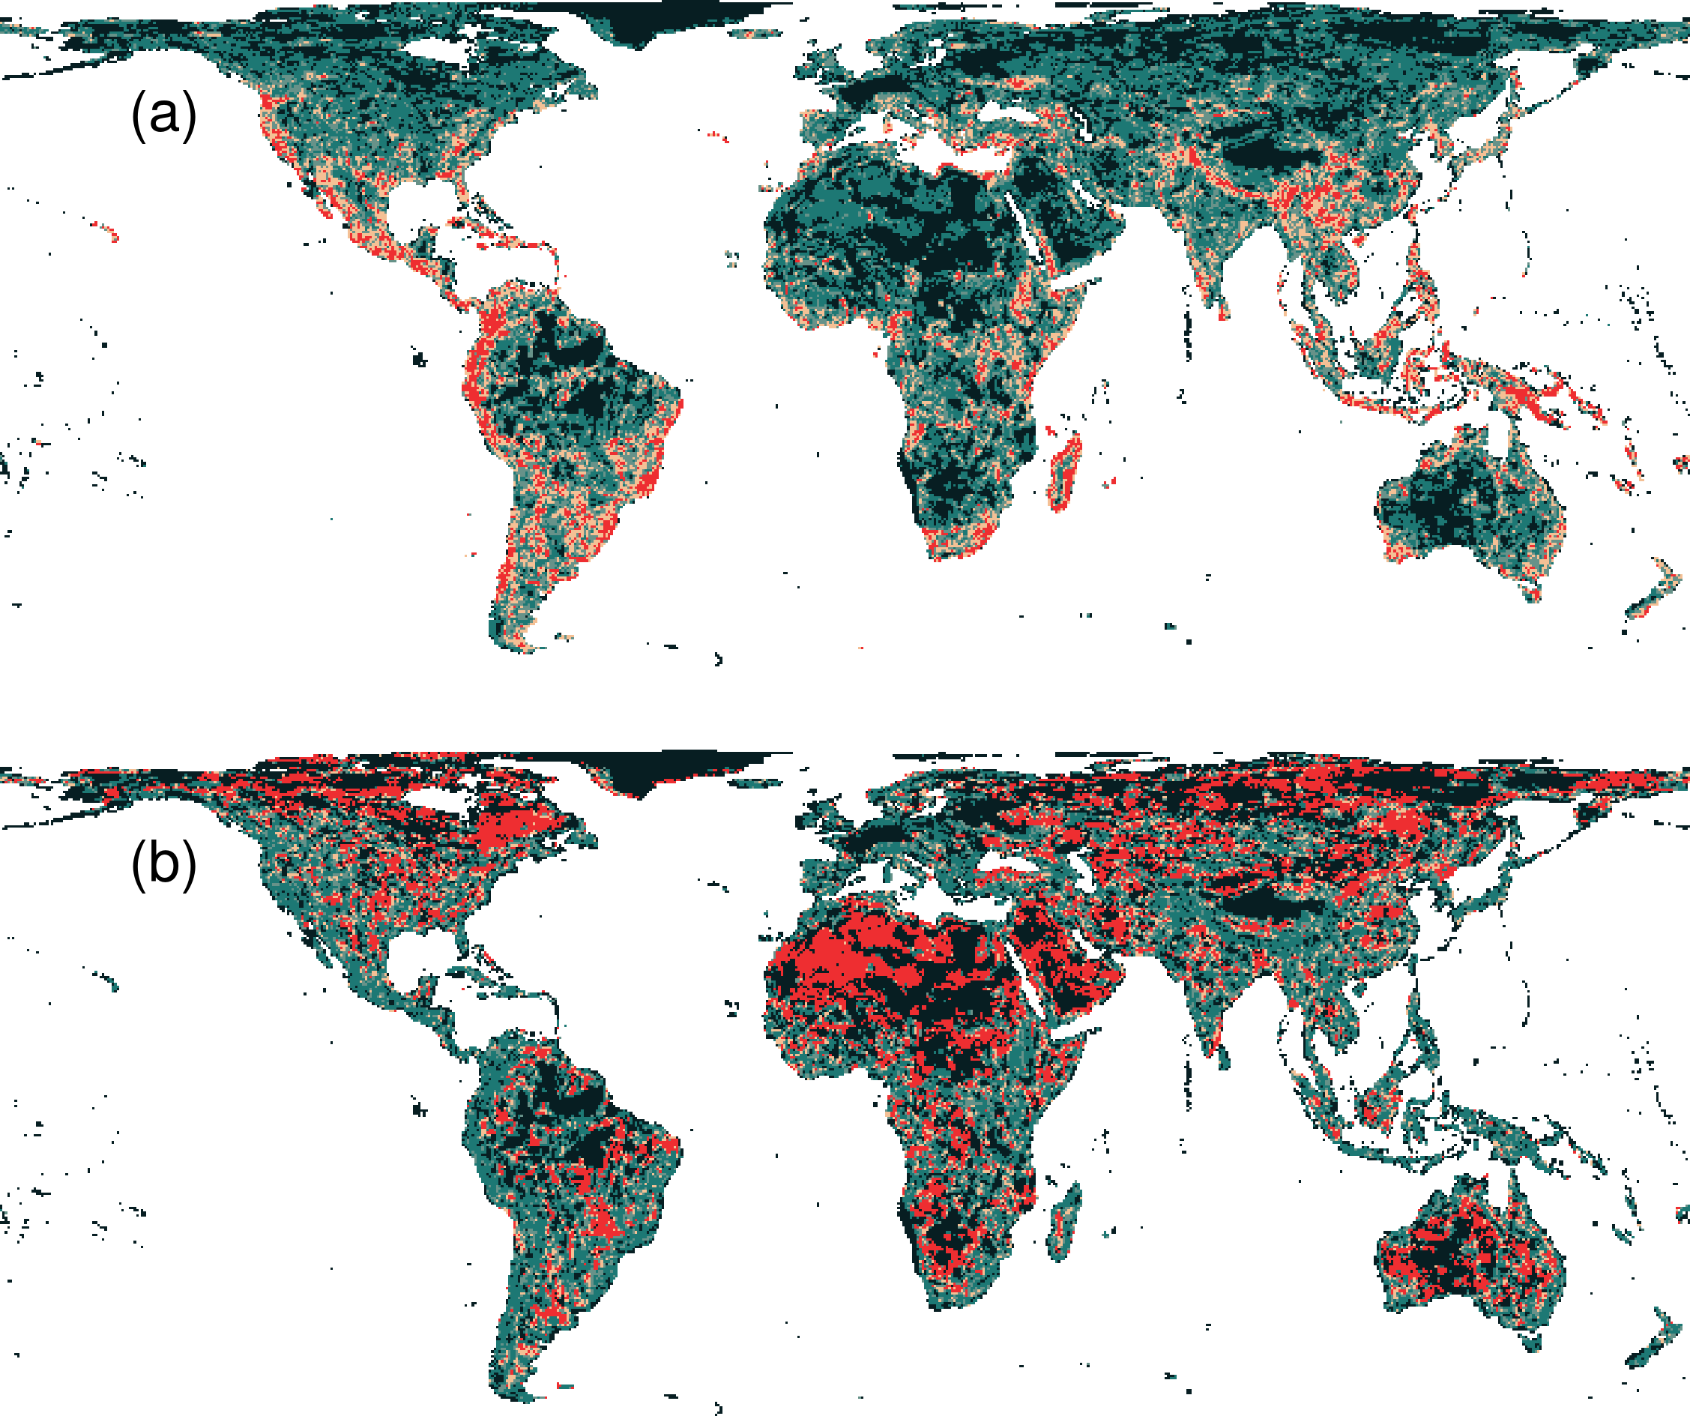
Prioritization for realized niches
35.9 % of the Earth’s land needed to complement existing protected areas
Biodiversity hotspots are critically important
Conservation efforts needed across the planet

Slide 47
Prioritization for realized niches
Prioritization that ignores environmental variation:
fails to represent 10,517 species
neglects areas outside of biodiversity hot spots

Slide 48
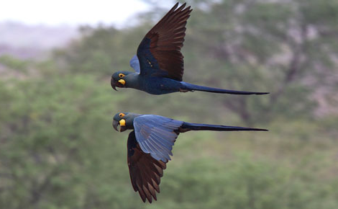
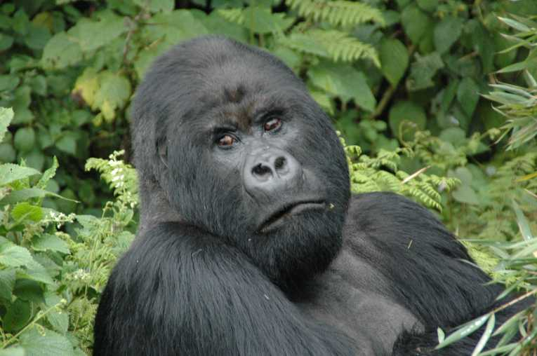
Global conservation of realized niches
Current protected area system is insufficient
More protected areas are needed to fill the gaps
Future conservation efforts need to explicitly account for environmental variation

Slide 49

Try it yourself?
raptr R package
Prioritise intra-specific variation
prioritizr R package
Formulate and solve custom-tailored prioritization problems
Constraints to represent species in contiguous areas or cluster reserves
Solve large problems fast!
Hanson et al. (2017) 10.1111/2041-210X.12862
https://prioritizr.github.io/prioritizr

Slide 50
Take home messages
If you really want it: you need to plan for it
Surrogates may work for some applications of genetic data – no guarantees!

Slide 51



jeffrey.hanson@uqconnect.edu.au
github.com/jeffreyhanson
jeffrey-hanson.com

